Slide 1
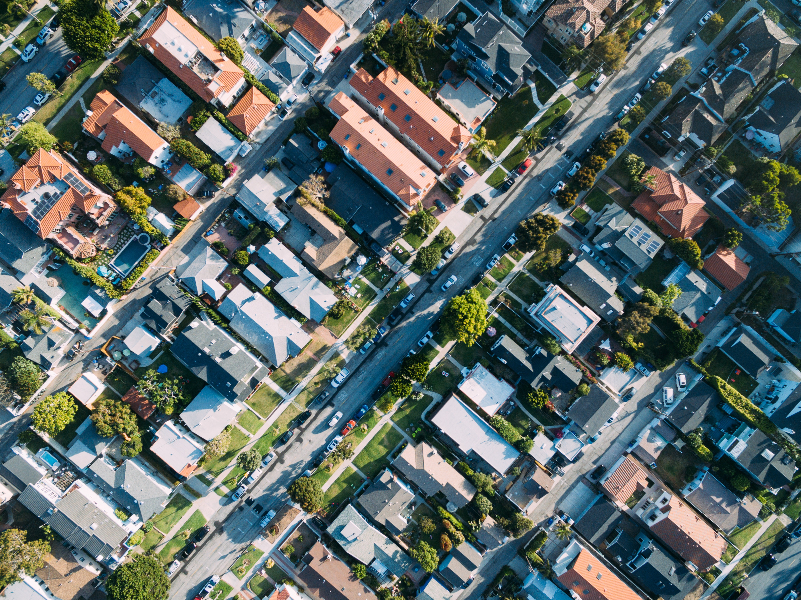
Hypothesis Testing: House Prices in Ames, Iowa
The Great Recession, Year Built & Remodelled, Neighborhood

Slide 2
Data
Five-year data (2006 – 2010) of house prices in Ames, Iowa, with 1460 observations, which includes year built, lot area, neighborhoods, house styles and property details
Source: https://www.kaggle.com/c/house-prices-advanced-regression-techniques/data
Notes:
https://www.kaggle.com/c/house-prices-advanced-regression-techniques/data

Slide 3

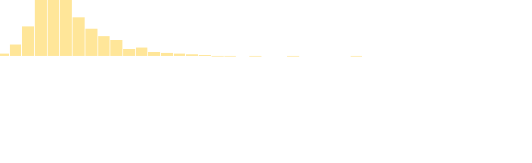
Descriptive Statistics
Sale Price | SalesPrice
Mean | 180,921
Standard Error | 2,079.11
Median | 163,000
Mode | 140,000
Standard Deviation | 79,442.50
Sample Variance | 6,311,111,264
Kurtosis | 6.54
Skewness | 1.90
Minimum | 34,900
Maximum | 755,000
Count | 1,460
Notes:
The test variables' samples are approximately normally distributed. Given the sample size, the distribution of sample means will be approximately normal according to the Central Limit Theorem.

Slide 4
Is there a significant price difference pre and during recession ?
 |  | Pre Recession | During Recession | % Change
North | New | $ 220,372 | $ 197,455 | -11.6%
 | Old | $ 149,490 | $ 142,068 | -5.2%
South | New | $ 220,251 | $ 215,852 | -2.0%
 | Old | $ 154,412 | $ 149,905 | -3.0%
Notes:
Housing crisis (late ‘07)
The Great Recession (late ‘08)

Slide 5
Hypothesis Testing
A/A Test
The Average Home
1-story and 2-story homes with 1-6 bedrooms, 1 kitchen, no pool and no misc feature. Average lot area is 10,505 sq ft after excluding frontage on 3 sides of property and cul-da-sac
Property details
Quality and condition
T-test
Ho: μ1 - μ2 = 0 Ha: μ1 - μ2 ≠ 0
µ₁ = population mean of group 1
µ₂ = population mean of group 2
Notes:
Controlling for:
The Average Home
1-story and 2-story homes with 1-6 bedrooms, 1 kitchen, no pool and no misc feature. Average lot area is 10,505 sq ft after excluding frontage on 3 sides of property and cul-da-sac
Brick & tile, cinder block, or poured concrete foundation, paved street and driveway, no alley, regular or slightly irregular shape of property, near flat/level contour and gentle slope, hip or gable roofs with standard (composite single), all public utilities with typical functionalities, and normal proximity condition.
Quality and condition are Average – Excellent.

Slide 6
Not enough evidence of price difference pre and during recession
Ho: μ1 - μ2 = 0 Ha: μ1 - μ2 ≠ 0
µ₁ = population mean of sale price pre recession
µ₂ = population mean of sale price during recession
*Reject null if t Stat > t Critical
*Reject null if p < 0.05
North - New
 | Pre Recession | Recession
Mean | 250,560 | 261,643
Variance | 7,292,970,537 | 11,131,294,757
Observations | 89 | 57
df | 101
t Stat | -0.67
P(T<=t) two-tail | 0.51
t Critical two-tail | 1.98
total sample size | 146
mean difference | -11,084
standard error of difference | 16,650
margin of error | 33,030
Lower limit | -44,113
Upper limit | 21,946
Notes:
https://www.bloomberg.com/news/articles/2015-06-22/here-are-the-15-cities-that-have-done-the-best-and-the-worst-since-the-recession
The slight decrease in housing prices in 2008 is not significant at any meaningful level of confidence.

Slide 7
South - New
 | Pre Recession | Recession
Mean | 215,028 | 200,748
Variance | 3,853,488,615 | 2,246,850,957
Observations | 62 | 62
t Stat | 1.44
P(T<=t) two-tail | 0.15
t Critical two-tail | 1.98
total sample size | 124
mean difference | 14,280
standard error of difference | 9,919
margin of error | 19,650
Lower limit | -5,370
Upper limit | 33,930
*Reject null if t Stat > t Critical
*Reject null if p < 0.05

Slide 8
*Reject null if t Stat > t Critical
*Reject null if p < 0.05
North - Old
 | Pre Recession | Recession
Mean | 171,384 | 160,948
Variance | 4,007,871,065 | 2,386,400,829
Observations | 50 | 49
t Stat | 0.92
P(T<=t) two-tail | 0.36
t Critical two-tail | 1.99
total sample size | 99
mean difference | 10,436
standard error of difference | 113,512
margin of error | 22,545
Lower limit | -12,109
Upper limit | 32,981
South - Old
 | Pre Recession | Recession
Mean | 154,751 | 146,376
Variance | 2,149,715,891 | 1,675,738,785
Observations | 43 | 26
t Stat | 0.78
P(T<=t) two-tail | 0.44
t Critical two-tail | 2.00
total sample size | 69
mean difference | 8,375
standard error of difference | 10,698
margin of error | 21,414
Lower limit | -13,039
Upper limit | 29,789

Slide 9
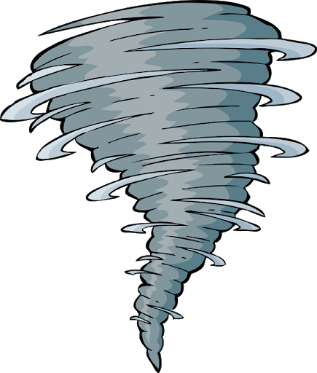
Is there a significant price difference of finished and and unfinished basement?
Ho: μ1 - μ2 = 0 Ha: μ1 - μ2 ≠ 0
µ₁ = population mean of sale price of finished basement
µ₂ = population mean of sale price of unfinished basement
 |  |  | Average Sale Price | % Difference
North | New | Finished | $ 223,105 | + 2.0%
 |  | Unfinished | $ 218,731
 | Old | Finished | $ 167,560 | + 12.9%
 |  | Unfinished | $ 146,021
South | New | Finished | $ 223,378 | +4.8%
 |  | Unfinished | $ 212,612
 | Old | Finished | $ 151,798 | +4.0%
 |  | Unfinished | $ 145,725

Slide 10
Not enough evidence of price difference of finished and unfinished basement
North - New
 | Finished | Unfinished
Mean | 281,631 | 249,649
Variance | 11,777,093,437 | 8,250,663,588
Observations | 30 | 168
t Stat | 1.52
P(T<=t) two-tail | 0.14
t Critical two-tail | 2.03
total sample size | 198
mean difference | 31,982
standard error of difference | 21,016
margin of error | 42,583
Lower limit | -10,601
Upper limit | 74,565
South - New
 | Finished | Unfinished
Mean | 203,325 | 207,604
Variance | 2,464,778,478 | 2,957,084,818
Observations | 24 | 131
t Stat | -0.38
P(T<=t) two-tail | 0.70
t Critical two-tail | 2.03
total sample size | 155
mean difference | -4,279
standard error of difference | 11,192
margin of error | 22,746
Lower limit | -27,025
Upper limit | 18,466
*Reject null if t Stat > t Critical
*Reject null if p < 0.05

Slide 11
*Reject null if t Stat > t Critical
*Reject null if p < 0.05
North - Old
 | Finished | Unfinished
Mean | 168,631 | 164,382
Variance | 3,152,756,375 | 2,722,977,909
Observations | 27 | 104
t Stat | 0.36
P(T<=t) two-tail | 0.72
t Critical two-tail | 2.02
total sample size | 131
mean difference | 4,249
standard error of difference | 11,956
margin of error | 24,204
Lower limit | -19,955
Upper limit | 28,453
South - Old
 | Finished | Unfinished
Mean | 161,504 | 148,897
Variance | 3,734,723,968 | 1,726,301,874
Observations | 21 | 67
t Stat | 0.88
P(T<=t) two-tail | 0.39
t Critical two-tail | 2.06
total sample size | 88
mean difference | 12,607
standard error of difference | 14,269
margin of error | 29,331
Lower limit | -16,723
Upper limit | 41,938

Slide 12
Conclusion
The value of a house in Ames, a city with tornados, does not necessary increase if basement is finished
People don’t usually take into account for the basements when purchasing a house
Collect more data for average homes that are newer and in North neighborhood for finished and unfinished basements

